Slide 1
Project 2
Ames vacation house price
Here is how you get richer

Slide 2
AGENda
Introduction
eda
model
recommendations
Problem statement and purpose of this presentation
Which features matter and which do not
Which model was utilise
What to do next for your vacation house

Slide 3
01
Introduction

Slide 4
Problem statement
We are personal assistants to an ultrarich family. The head of the family (who shall not be named), has approached us to increase their vacation house value.

Slide 5
Purpose
Housing data from 2006 to 2010
Identify features to maximise value

Slide 6
Situation
Chaotic housing market in 2021
Demand of house > Supply of house

Slide 7
DATA set
Total number of features: 81
Nominal
01
02
ORDInal
Alley access
Misc features
House style
External Quality
External Conditions
Overall condition
Continuous
Discrete
Lot frontage
Sale prices
Square feets
Number of bathrooms
Number of fireplaces
Garage cars
03
04
Notes:
39 Numerical - 11 Discrete, 28 Continuous
42 Categorical - 14 Ordinal, 28 Nominal.

Slide 8
02
EDA

Slide 9
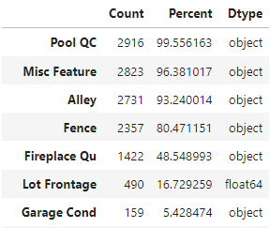
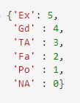

DATA TREATMENT
FILLING THE NULL
Impute with Mean, Mode, 0
27 Features
TREATING THE ORDINAL
With Ratings
- Quality
- Conditions
- Yes No
HANDLe THE DISCRETE
Years, Month into Strings
Notes:
To increase the data set reliabilities, we have to do data cleansing. The null has to be filled. Either with Mean, Median or Mode or with either 0 / NA

Slide 10
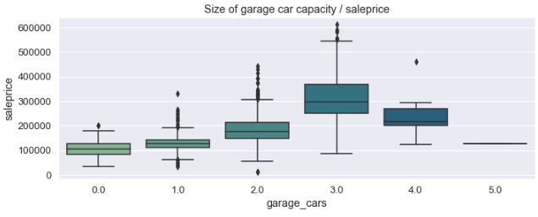
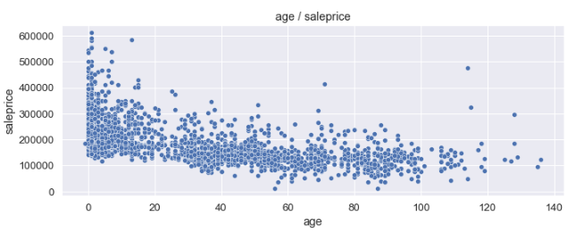
INTERESTING FACT

Slide 11
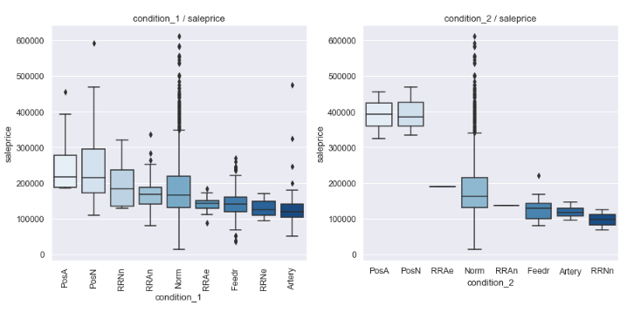
INTERESTING FACT
Notes:
Near positive off-site feature--park, greenbelt
Adjacent to postive off-site feature

Slide 12
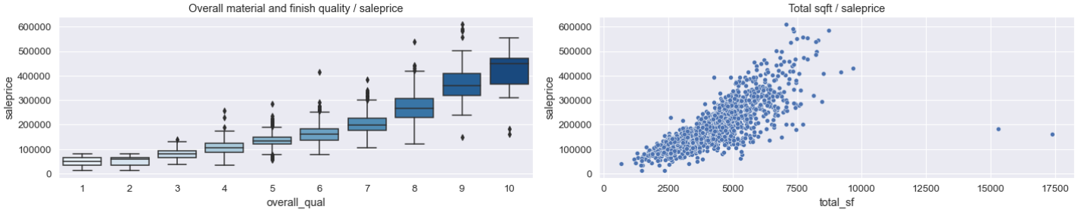
INTERESTING FACT

Slide 13
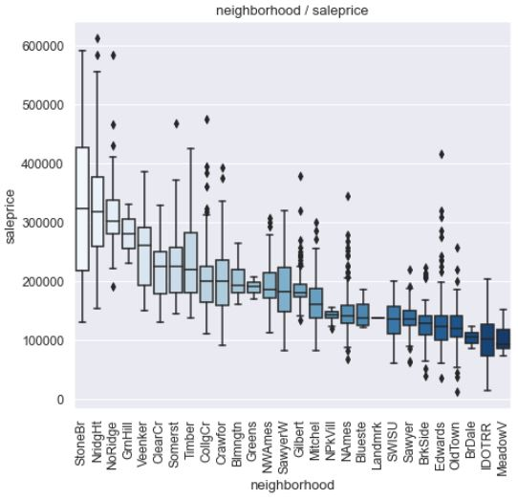
INTERESTING FACT
The Top 3 expensive neighbourhood price vs the Cheapest neighbourhood
Notes:
Median Price is 3 times more

Slide 14
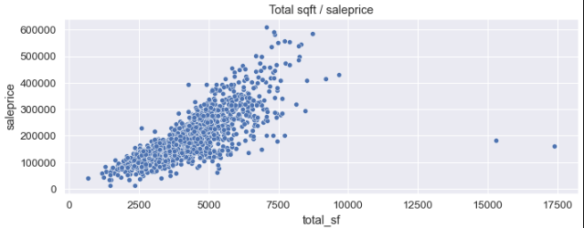
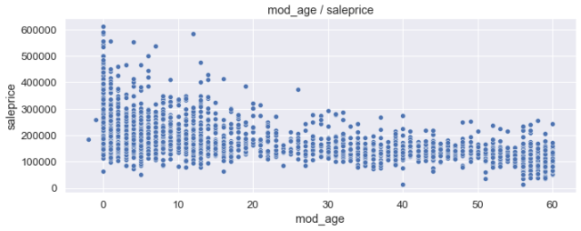
The outliers

Slide 15
Important Features
Overall MAterial Qual
Total SQ FT
Exterior quality
Garage car capacity
YEAR AGE

Slide 16
03
Model

Slide 17
Model comparison
 | Linear regression | Ridge model | Lasso model
R2 score | 0.896775 | 0.900355 | 0.902288
RMSE score | 3.993135e+17 | 2.599011e+04 | 2.581143e+04

Slide 18

LASSO MODEL
Based on the highest R2 score and lowest RMSE score

Slide 19
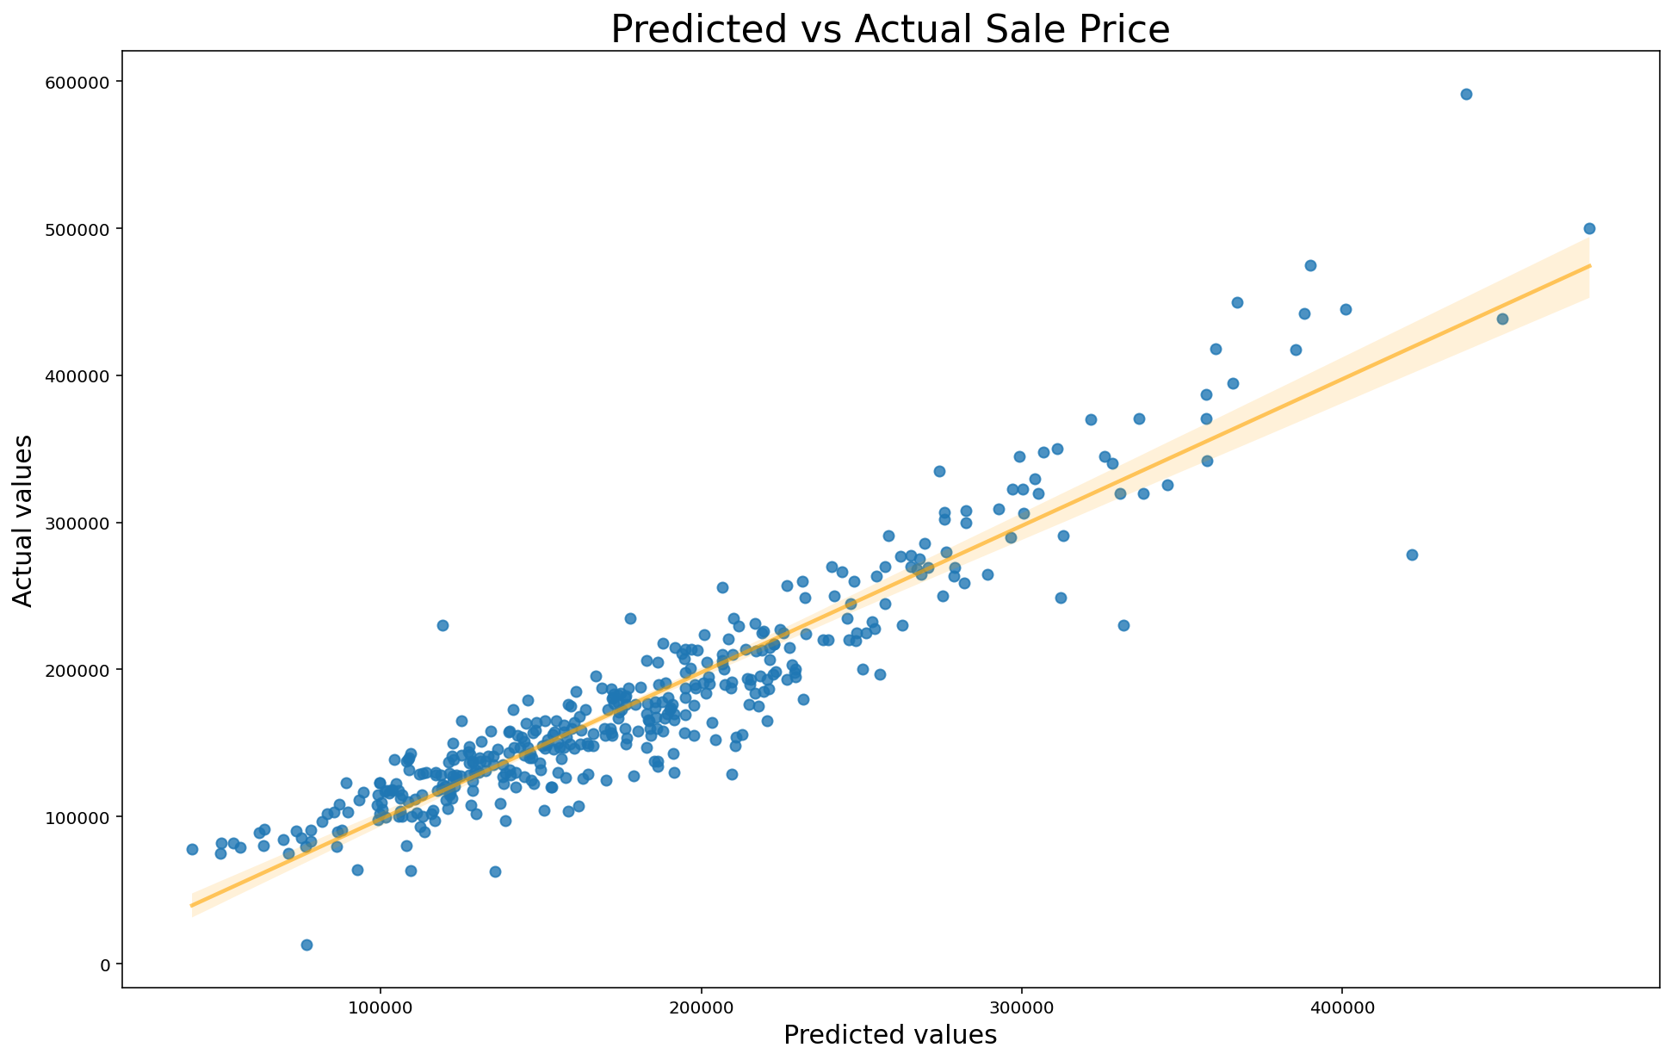
Predicted vs actual price

Slide 20
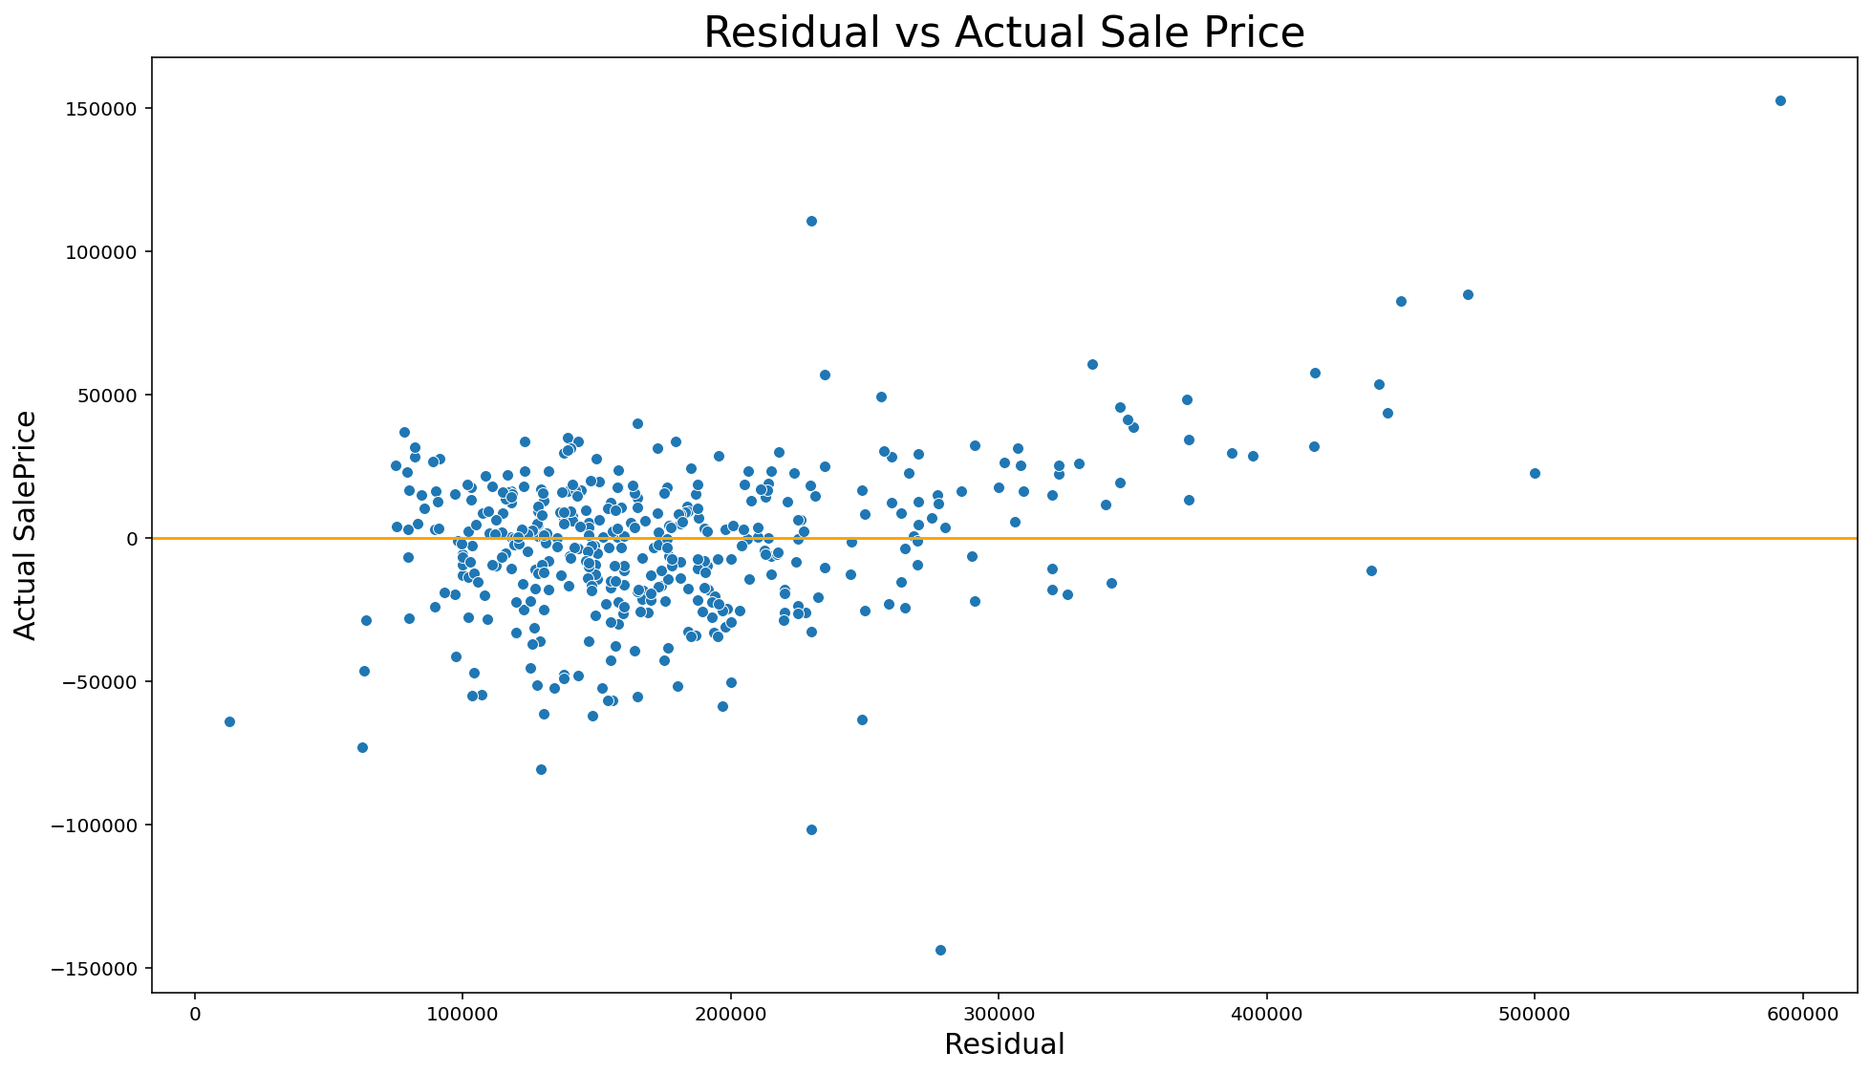
RESIDUAL PLOT

Slide 21
TOP PREDICTORS
TOTAL SQUARE FEET
OVERALL QUALITY
Above GROUND LIVING AREA
NEIGHBORHOOD

Slide 22
Further exploration
USING AUTOMATED FEATURE SELECTION
Use machine learning tools
Better imputation method
Study negative correlation

Slide 23
04
REcommendation

Slide 24
recommendations
The recommendation is to sell the house as soon as possible once the appropriate enhancements to the house have been done.
The appropriate enhancements:
Increase the ground living area
Increase the basement square feet
Improve on the material and finish of the house
Improve the kitchen quality
Improve on the basement quality

Slide 25
thanks!
Do you have any questions?

